Slide 1
Animal responses to the biotic environment

Slide 2
Intraspecific aggressive responses
Aggression is belligerent behaviour that arises from competition.
One animal killing and eating another animal is not aggressive.
If an animal turns and fights, it can lead to aggression.
Aggressive intraspecific behaviours include fighting, territoriality and hierarchies.

Slide 3
Fighting — agonistic behaviour
Agonistic behaviour is aggressive behaviour towards another member of the same species involving threat or fighting.
It is a contest to determine who gains access to a resource, such as food or a mate.
It may just be a test of strength but is often, symbolic ritualised behaviour that avoids an actual fight.
Threat displays often lead to submission or appeasement by one of the competitors. The more scarce the resource, the more intense the fighting.

Slide 4
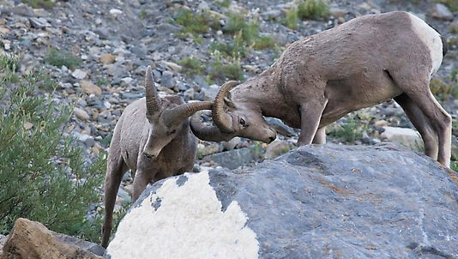
Animals of the same species compete for the same resources, so competition between them is the strongest.
In-fighting between members of the same species is ritualised. One wins, one loses, no one gets badly hurt.

Slide 5
The most vicious fighting takes place between individuals that can’t really hurt each other, such as hornless female antelope. Well armed animals avoid attacking exposed body areas of opponents
  e.g. a horned antelope will gore an attacking lion, but won’t aim its horns at the sides of another antelope.
Fighting to the death is non-adaptive to most animals.
Fighting to the death does sometimes occur. It usually eliminates a stranger from another group.

Slide 6
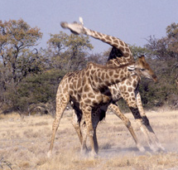
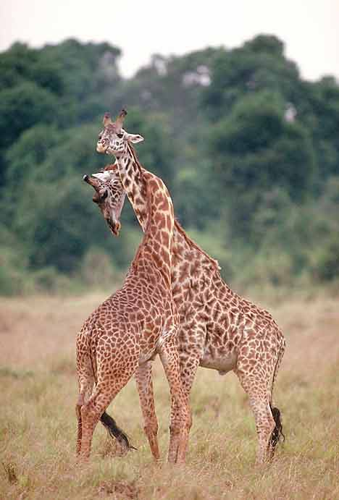
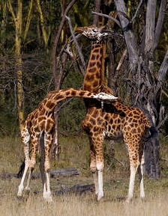

Slide 7
Hierarchies
A hierarchy is a ranking system with a population.
Each member has a rank or status that determines their access to resources such as food and mates.
Rank is established and maintained by ritual displays such as postures and threats, and, occasionally biting, pecking or fighting.

Slide 8
Hierarchies (cont’d)
An individual’s status may depend on:
gender, size, age, strength, experience, intelligence, birthright, aggressiveness, appearance or stage in their reproductive cycle.

Slide 9
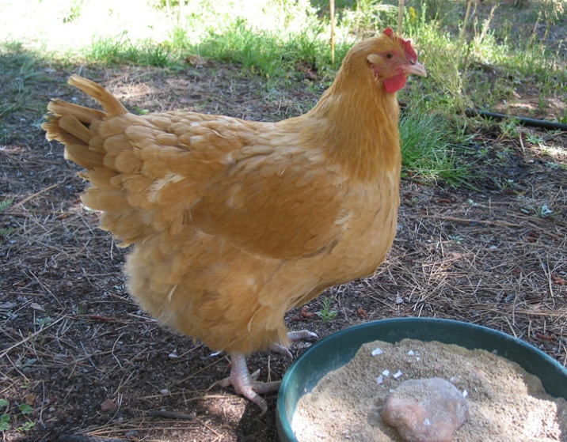
Linear Hierarchies
Pecking order.
Individuals are ranked from highest to lowest, alpha to omega.
  E.g. hens, any hen can peck those below her and can be pecked by those above.

Slide 10
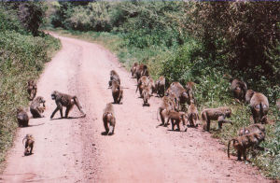
Complex Hierarchies
There may be sub-groups within the ranking system. E.g. in a baboon troop there may be dominant males, subordinate males, females with their own ranks, and juveniles.

Slide 11
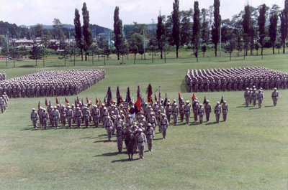
Human hierarchies
Humans have the most complex systems of all.

Slide 12
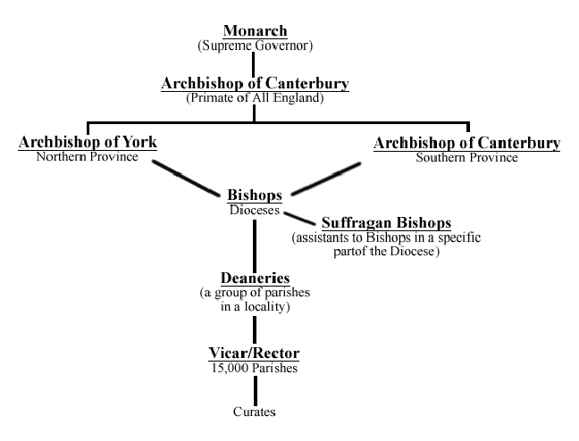

Slide 13
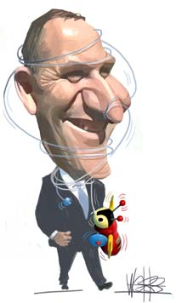
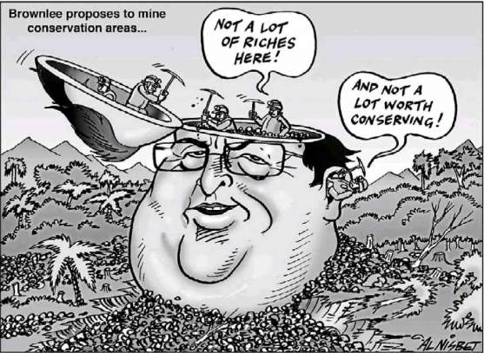


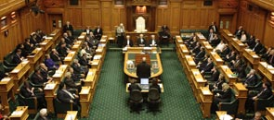
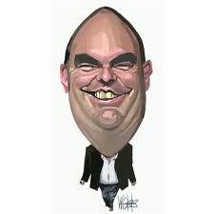
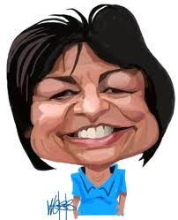

Slide 14

Then there’s always…
Principal
Deputy Principal
Associate Principal
HODs
Teachers
etc

Slide 15
Adaptive features of hierarchies
Reduces serious intraspecific aggression
Each individual knows its place which is maintained by ritualised dominant and submissive behaviours.
Lower ranked ones are less better off, but may still benefit by getting some resources and protection, and may rise up the rankings
The ‘fittest’ (strongest/healthiest etc.) contribute most to the gene pool.
Weakest, lowest ranked are less likely to pass on genes.

Slide 16
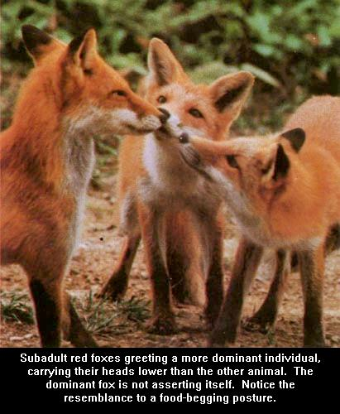
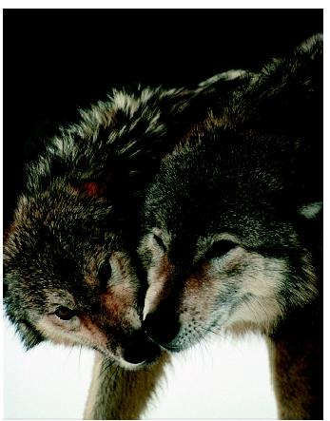
Dominant/Submissive behaviours

Slide 17
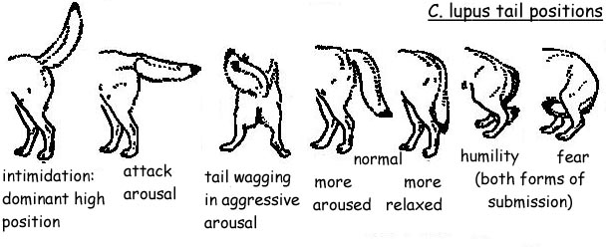

Slide 18
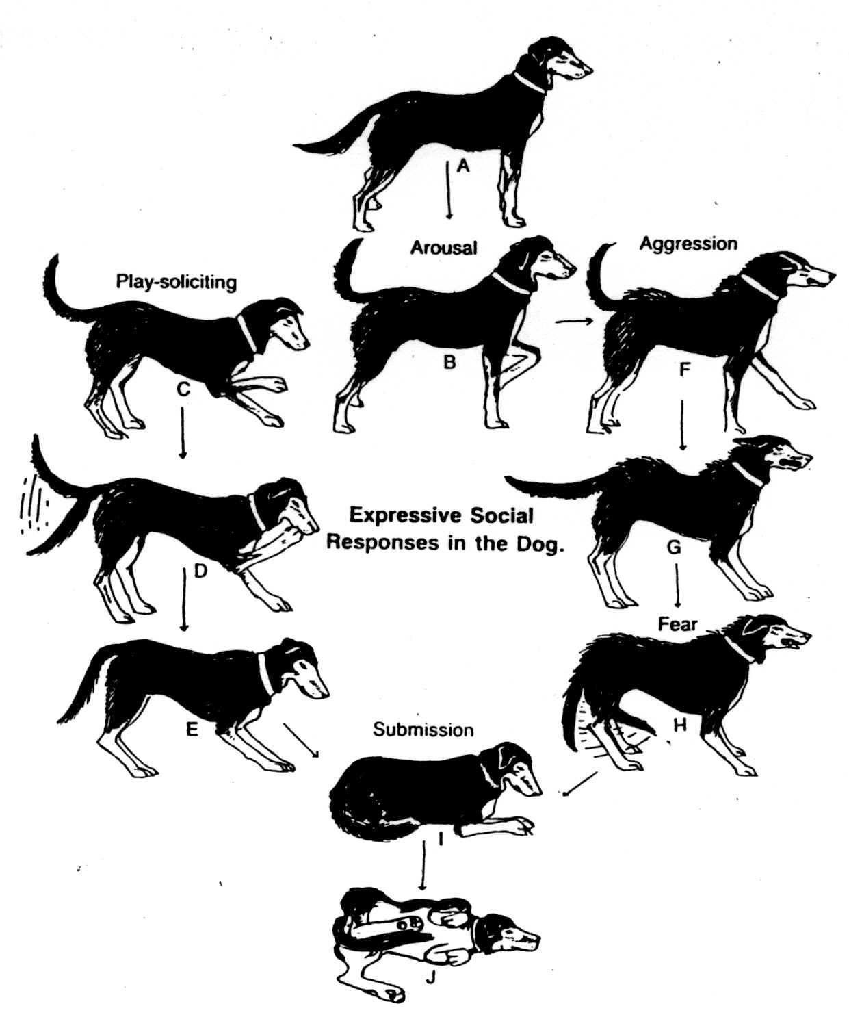
A-B Neutral to alert attentive positions.
C: Play-soliciting bow.
D-E: Active and passive submissive greeting - tail wags, ears fold back, weight is transferred to hind legs.
I: Passive submission.
J: Rolling over and showing belly and genitals.
F-H: Gradual shift from aggressive display to ambivalent fear/defensive/aggressive posture

Slide 19
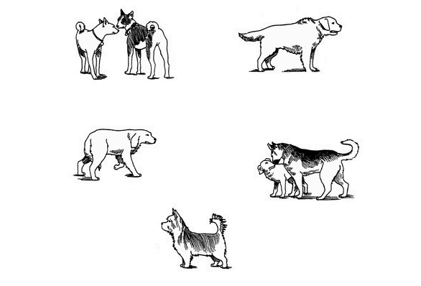
Staring down
Raised Hackles
Fearful threat
“t bone”
Defiant stance

Slide 20
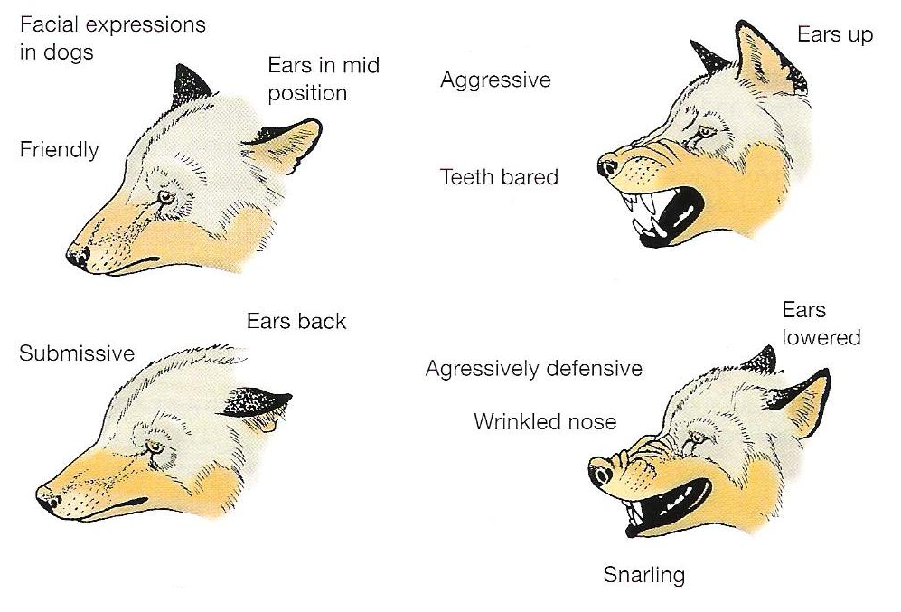

Slide 21
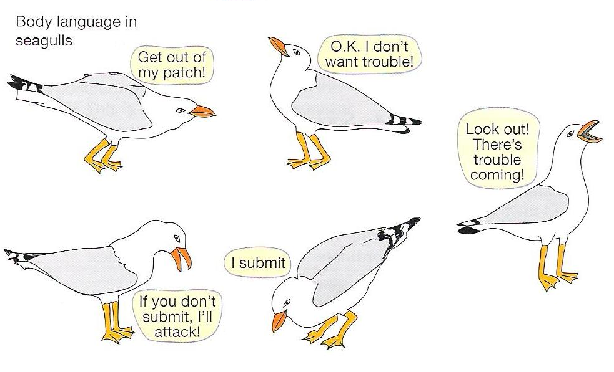

Slide 22
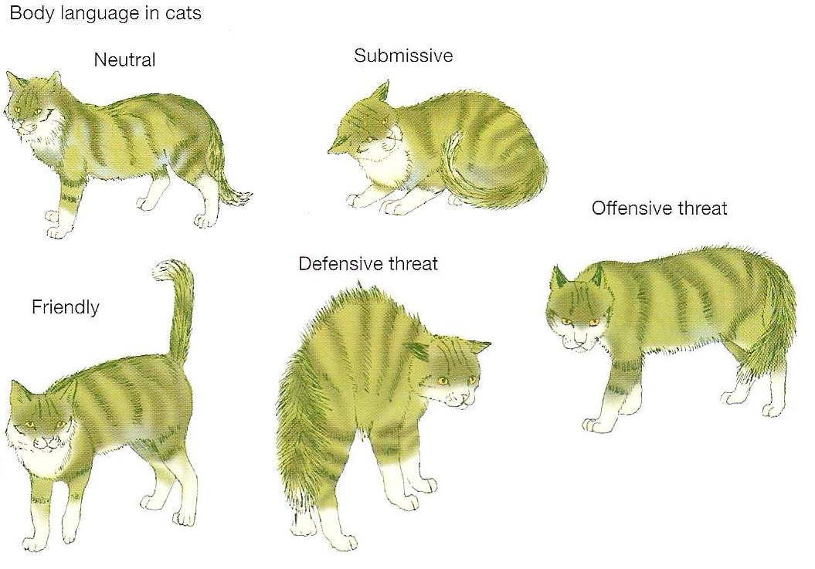

Slide 23
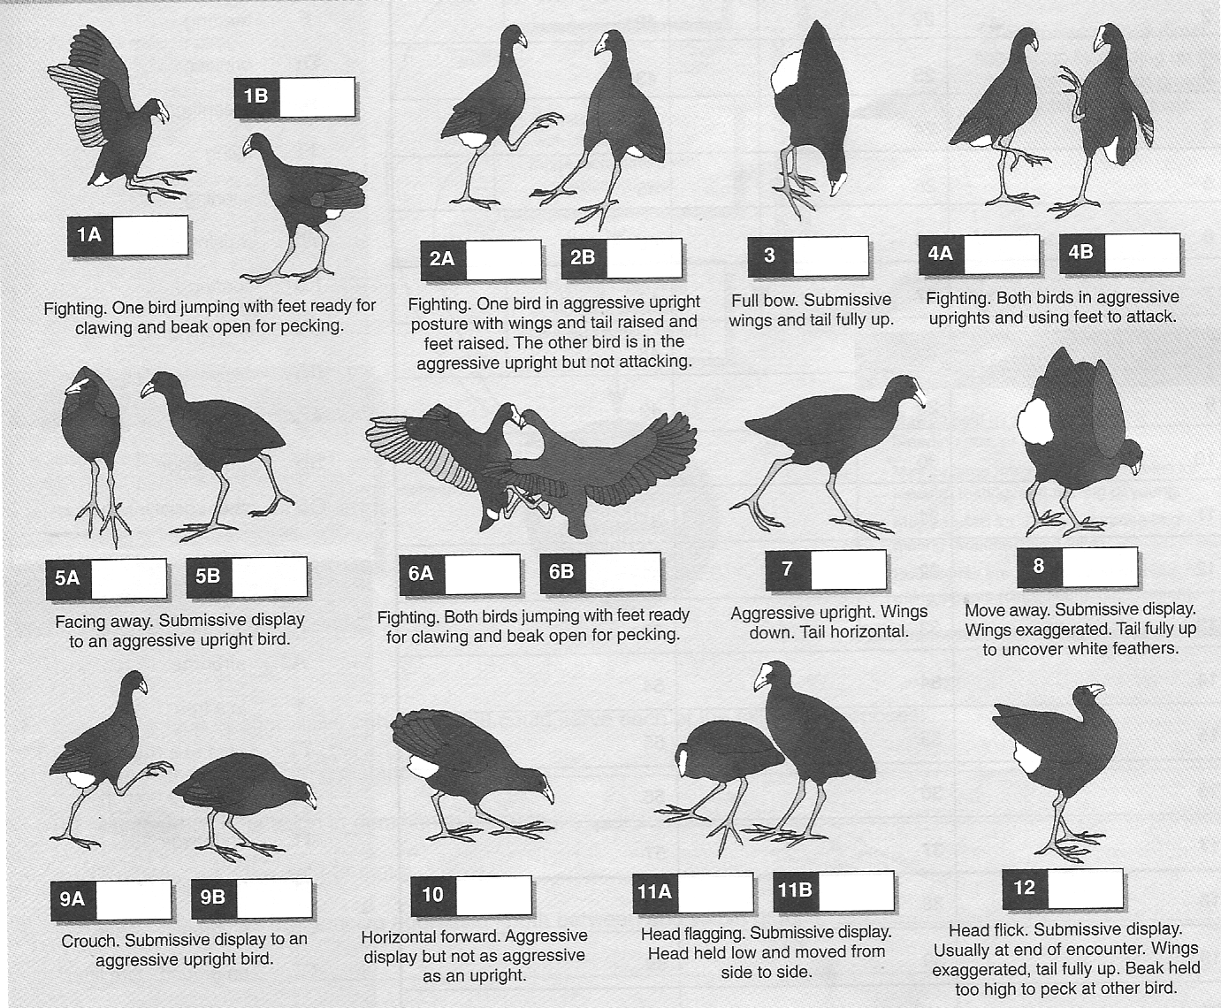

Slide 24
Territories
A territory is an area defended against other members of the same species
It is used for feeding, mating and or rearing young.
The area the animal covers regularly in search of food and mates is called the home range.

Slide 25

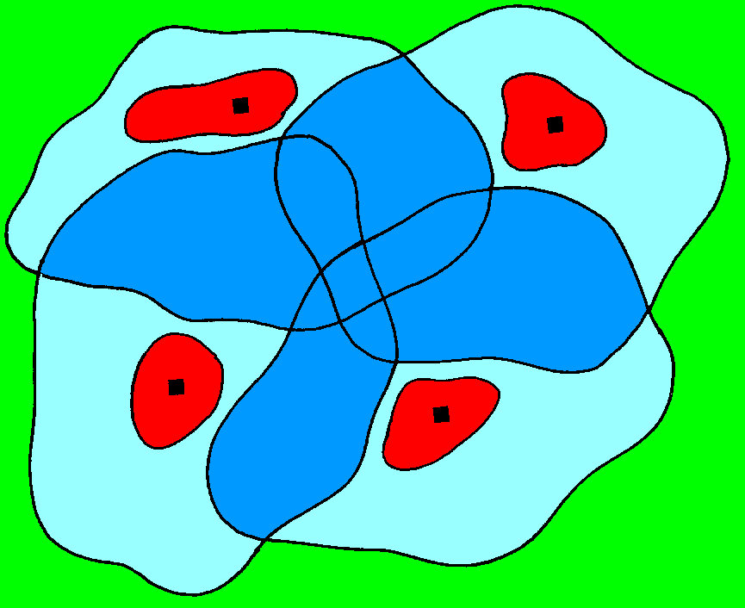
Territory and home range
Territory
Home ranges can overlap
Nest, den, or lair
Home range

Slide 26
Territories (cont’d)
Animals hold territory through aggressive behaviour. The strongest attacks are against members of the same species and the same sex.
Territories may be held by individuals, pairs or groups.

Slide 27
Adaptive features of territoriality
It ensures enough space for each animal, can keep the population down.
Reduce the spread of disease and parasites. It is also harder for predators to find them.
The most successful males hold the best territories, and so the best genes are handed on to the offspring.
Once the territories are established, the losers will spread out go elsewhere rather than go on fighting.

Slide 28
In some species, males without territories fail to breed.
Territories ensure enough food for the animals holding them.
Territories ensure a safe, protected nest or home for the young, or at least a place to breed in the case of communal breeding grounds.
The animal now has an area with which it can become very familiar. It can learn where the water, food and protection from predators is located.

Slide 29
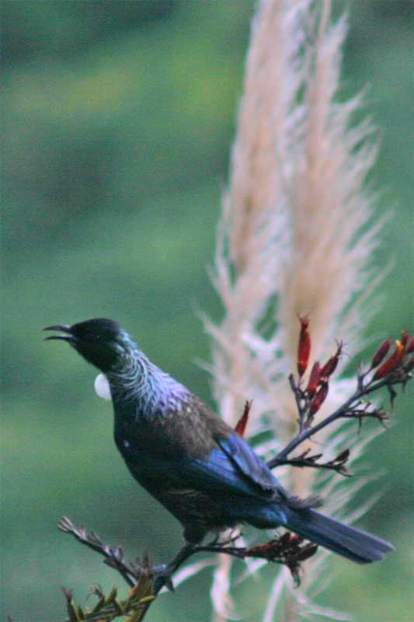
Marking and defending territories
Most animals regularly patrol their territories and mark them to proclaim ownership.
1 Birds mark their territories by singing on the boundaries of their areas at dawn and dusk. Often show off very colourful feathers.

Slide 30
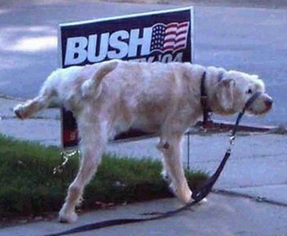
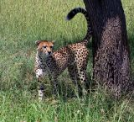
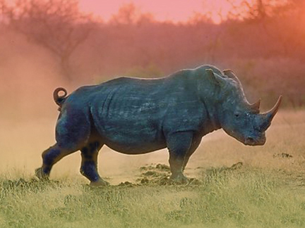
2 Animals mark with urine, e.g. dogs and cats, or dung, e.g.rhino.

Slide 31
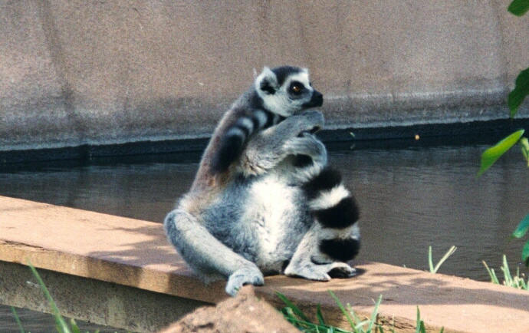
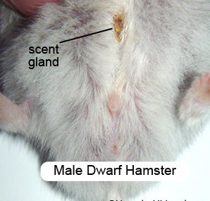
3. Animals have special scent glands. These can be on the rump, between the horns (in deer) or on the wrists (in the ring-tailed lemur). In cats it is just behind the ear.

Slide 32
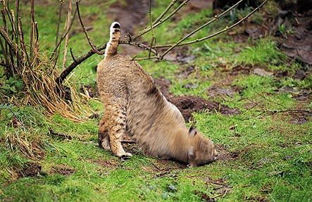
A bobcat leaves a message for other creatures by rubbing its facial scent glands on the ground. From such markings, animals can tell the age, gender and reproductive status of other creatures, and even learn what they've eaten last.

Slide 33
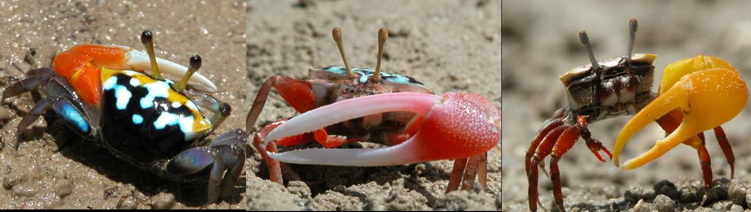
4. Animals, such as crabs, wave their claws in frantic signals on the perimeter of their areas.

Slide 34
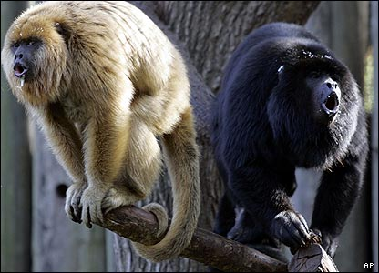
5. Howler monkeys give the loudest morning chorus of all the jungle animals.

Slide 35
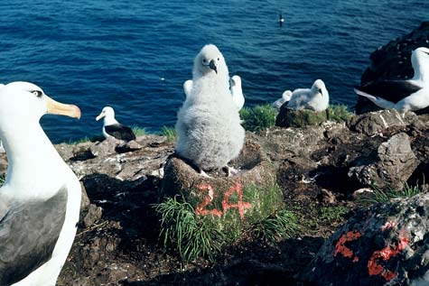
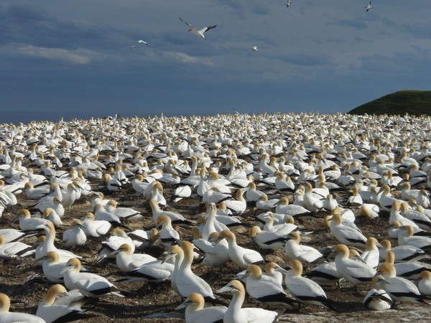
Many animals, such as sea birds, which range far and wide for most of the year may guard a territory only during the breeding season.
Gannet colony Cape Kidnappers
Albatross colony Campbell Island

Slide 36
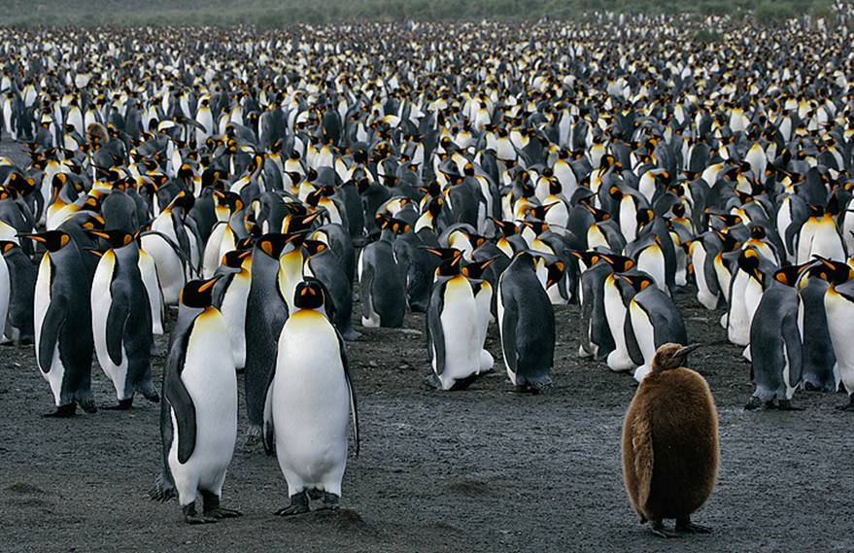

King penguins, Sth Georgia Island

